Slide 1

Exploring influenza cases in New York State with an interactive dashboard, trend comparison, and statistical analysis
Katherine Huerta
Deliverable 1
Data 606 SP 2020
https://www.nfid.org/infectious-diseases/influenza-flu/

Slide 2
Project
Explore seasonal influenza datasets to glean insights
Trends
Risk factors (location, population, vaccine coverage and effectiveness)
And more!
Determine the significance of trends/correlations
Using R and Python
Create an interactive dashboard
Enabling healthcare professionals and researchers to make inferences and/or decisions based on their expertise.
This may include preventative measures, preparedness, and outreach

Slide 3
Main Data Set and Source
Influenza Laboratory-Confirmed Cases By County: Beginning 2009-10 Season (HealthData.gov, 2020)
Originally from New York State Department of Health (health.data.ny.gov, 2020)
Weekly counts of laboratory-confirmed influenza cases and type from 2009-present in New York (State).
Nine Columns (Season, Region, County, CDC Week, Week Ending Date, Disease, Count, County Centroid, and FIPS)
62,286 rows
Other datasets will be used to supplement my findings
State Specific Influenza Vaccination Coverage (CDC, provided by Kaggle – 2019)
Population data, vaccine effectiveness (CDC), and more may be used.

Slide 4
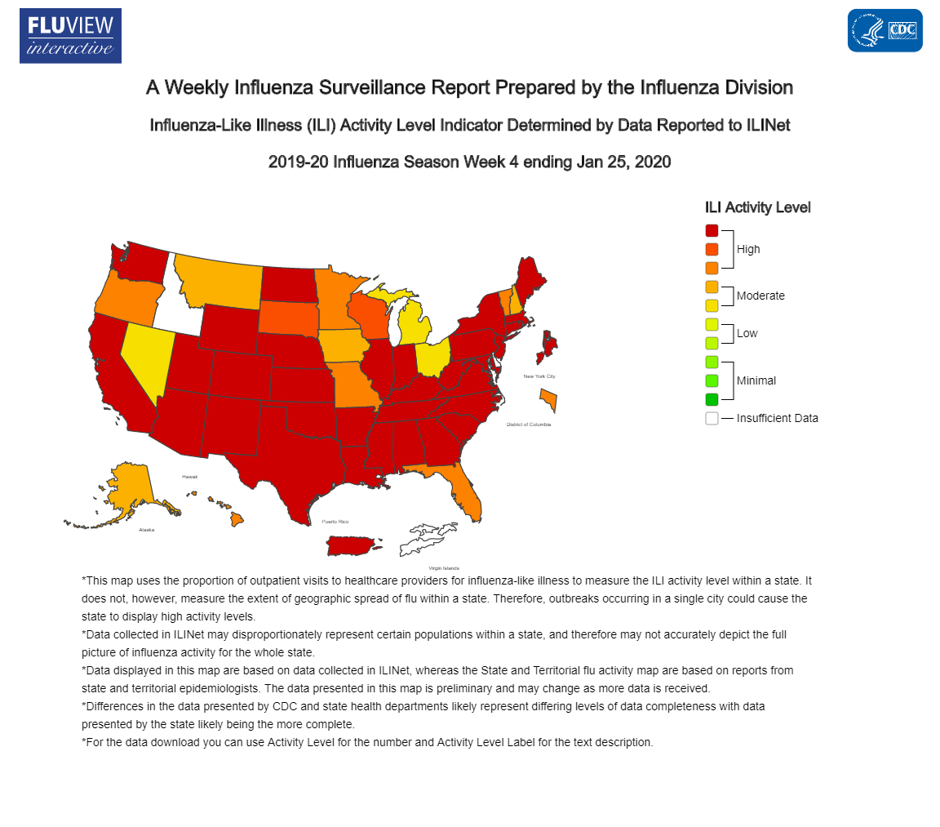
Rationale
Why is this important?
Seasonal flu is deadly and widespread
So far in this 2019-2020 flu season, an estimated 10,000 people have died and 180,000 hospitalized in the United States (Centers for Disease Control, 2020)
Seasonal flu data can help us better understand and prepare for the pandemic flu
Why New York State?
Has locations that range from highly populated to rural
High influenza-like illness activity (like most states currently)
Has up-to-date data
https://www.cdc.gov/flu/weekly/index.htm#ILIActivityMap

Slide 5
Questions and Feedback?
uv94014@umbc.edu
https://github.com/kathuerta/DATA606
Thank you!
https://www.nfid.org/infectious-diseases/influenza-flu/

